Slide 1
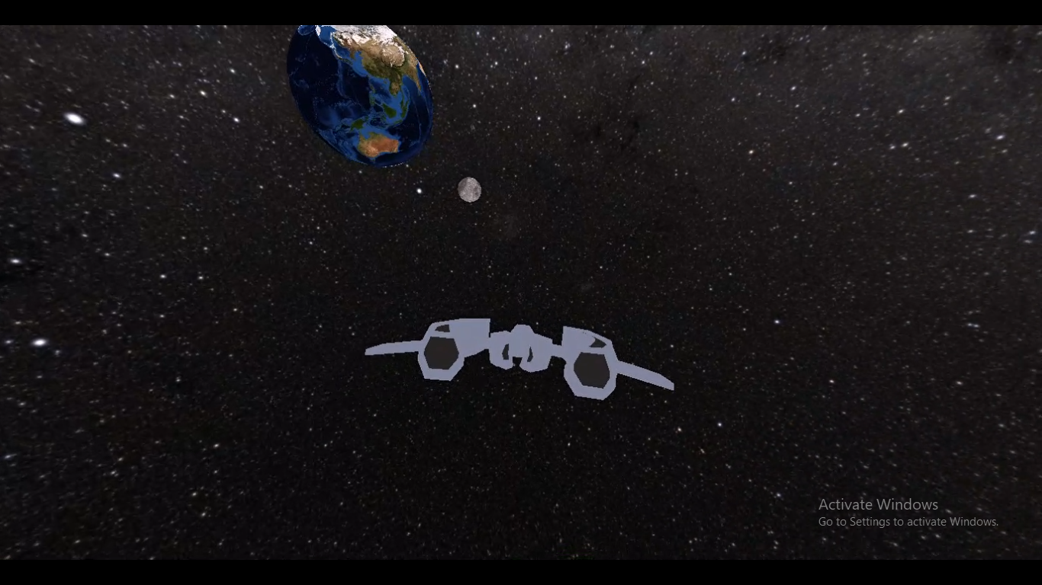
3rd Semester Project on OOP
Swastab Acharya(076BCT092)
Subas Adhikari(076BCT083)
Sailesh Shiwakoti(076BCT063)

Slide 2
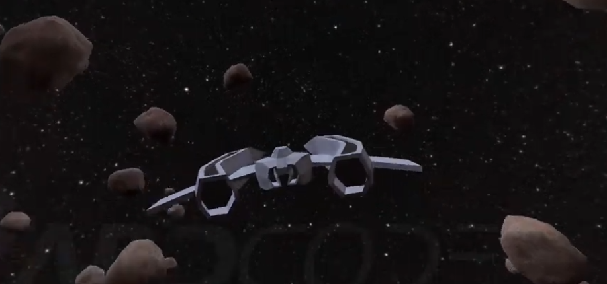
This game, SpaceRider is simply a use of matrices, vectors and other mathematical concepts to render an OBJ file created using applications like Blender by using the graphics pipeline created by DirectX and manipulating such objects like spaceship, asteroids, planets and controlling the camera and spaceship moments in an interactive way.
SpaceRider

Slide 3

This Game engine
This game consists of two parts :
Game Engine :
It consists of low level programs which are essential to create the environment for the main application / game. It consists of window handler, Input system graphics engine and physics engine. The developed engine is used for rendering meshes and their textures. Similarly, to handle the series of inputs given by user. In this app, physics engine is used for finding gravitational influence and to detect collision.
Main Application:
This part of program uses the game engine to render 3D objects and create real scenarios / fantasies for the game.In our game it is space fantasy. It part of program is used to decide the logic and interactions of the game that is actually played.

Slide 4
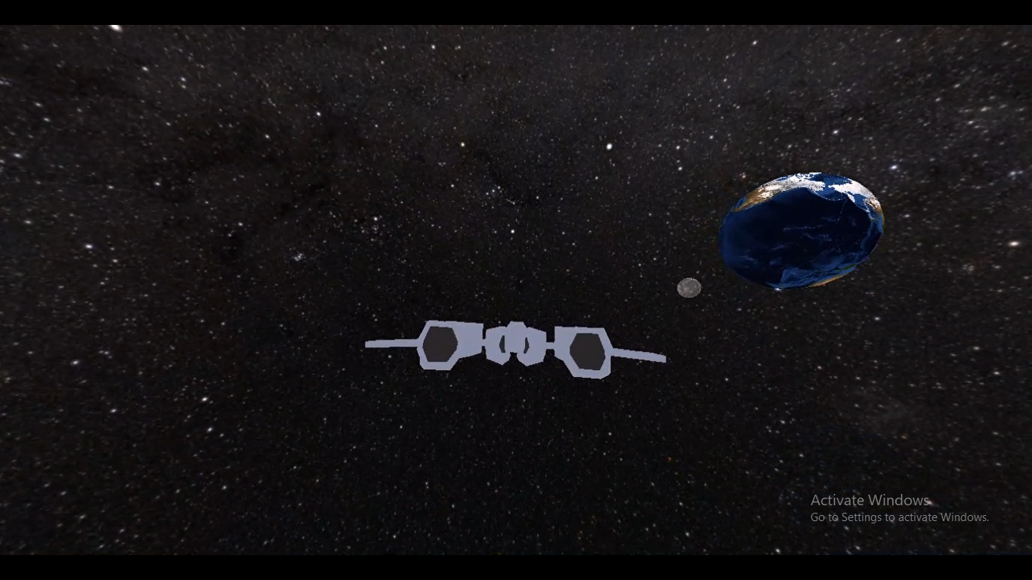
Space fantasy
In this game, the player is left on the space with spaceship, and it needs to return to its homeland Earth. So, it has to ride from the orbit behind the jupiter.
If it falls on the gravitational influence of other planets, than it can never escape from there thus, it fails to reach the earth. Similarly, if it strikes with asteroids, spaceship gets damaged, leaving no way to reach the earth. In this case also spaceship gets damaged. The mass of given spaceship is 25 kg. And other masses of heavenly bodies are standard.

Slide 5
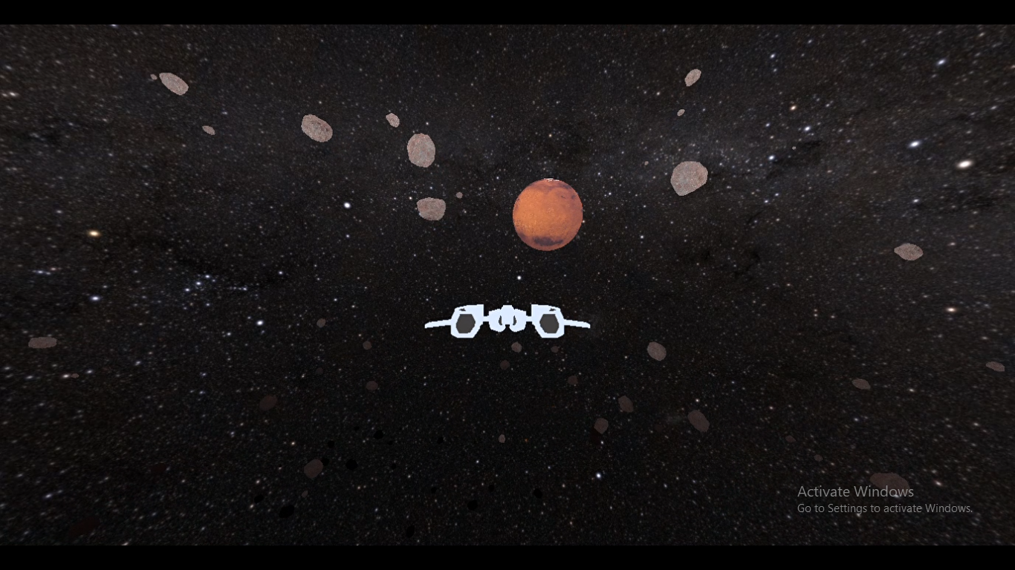
Classes Used:
Game Engine:
Material
It handles the 3D objects, their textures, vertices, indices and other properties.
Buffer System
ConstantBuffer, VertexBuffer and IndexBuffer are the classes to handle respective buffers
Shaders
PixelShader and VertexShader are the classes to handle pixel their colorations and vertex shading done while runtime.
SwapChain
This class handles swapchain which is collection of frame buffers that is used to show the render frame on the screen and also used for frame stabilization uses double buffering technique.
DeviceContext
This class handles device context which is an extension of Directx device that allows us to generate rendering commands to send to the video driver for execution. The driver then redirects the command to the GPU/CPU for final elaboration or final rendering on the screen and also allows us set pipeline states.
Material
This handles the material which is, in computer graphics, a substance or mixture of substances that constitute an object mainly defined by vertex and pixel shader.

Slide 6
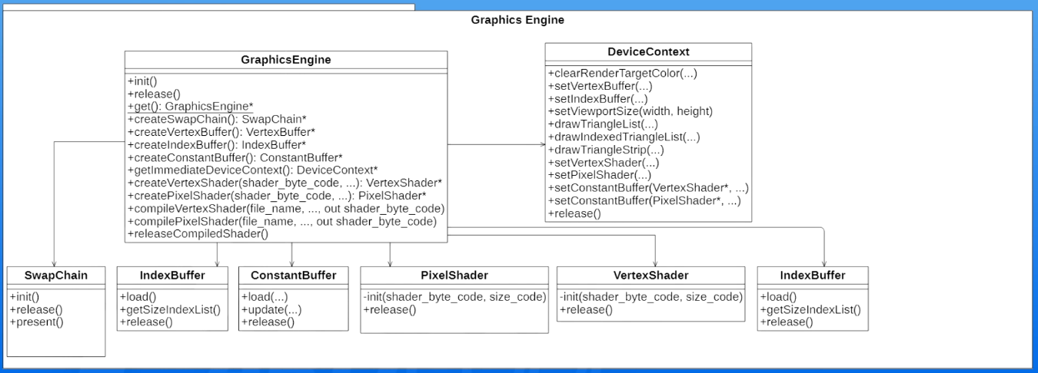
Class Diagram can be viewed as:

Slide 7
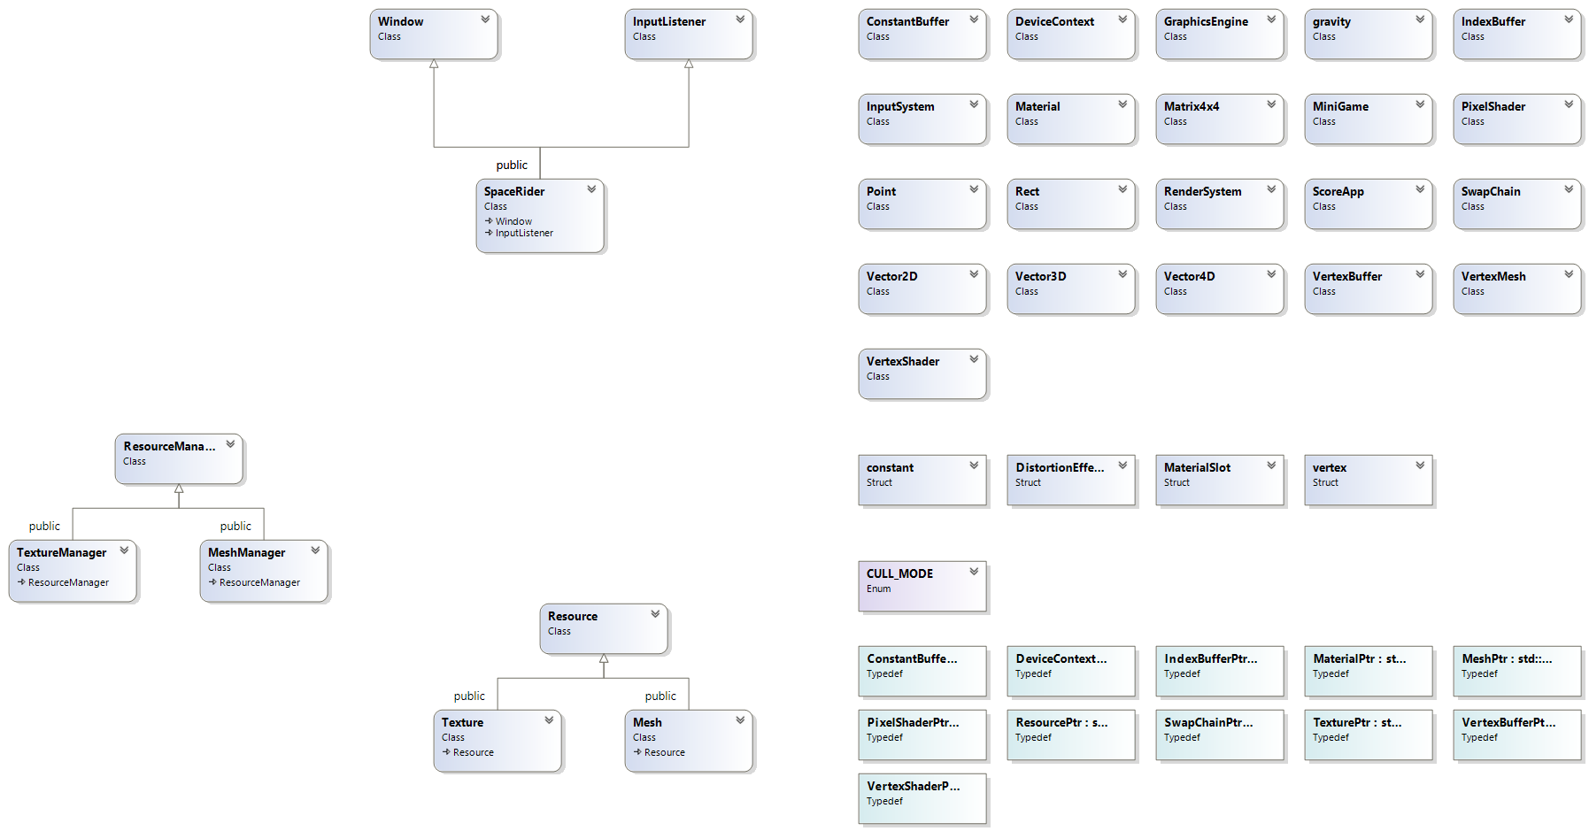
Class Diagram View

Slide 8
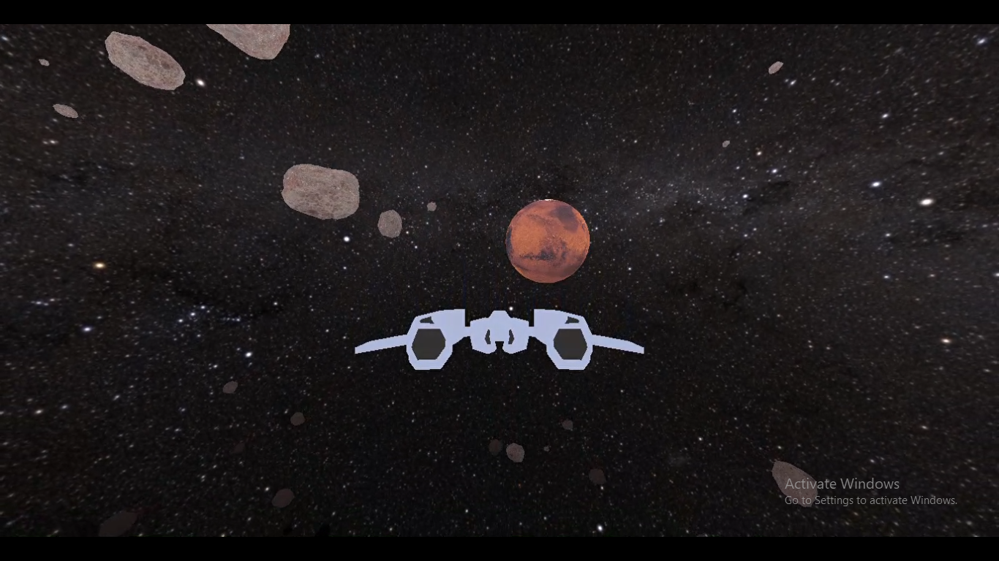
Math
This class handled transformation matrices viz. translation matrix, rotation matrix, and scale matrix which manipulates the coordinates of coordinate systems we used namely model coordinate space which is the system in which all the original position of 3D model are placed, world coordinate space which is the system in which we place all our 3D objects, view coordinate space which is system as seen by the camera and then finally screen or projection space in which coordinates as seen by the camera are projected either orthographically or by perspective method.
Resource Manager Classes
Mesh, MeshManager, Texture, TextureManager, are part of Resource Manager are the classes to handle and create Meshes,Textures.

Slide 9
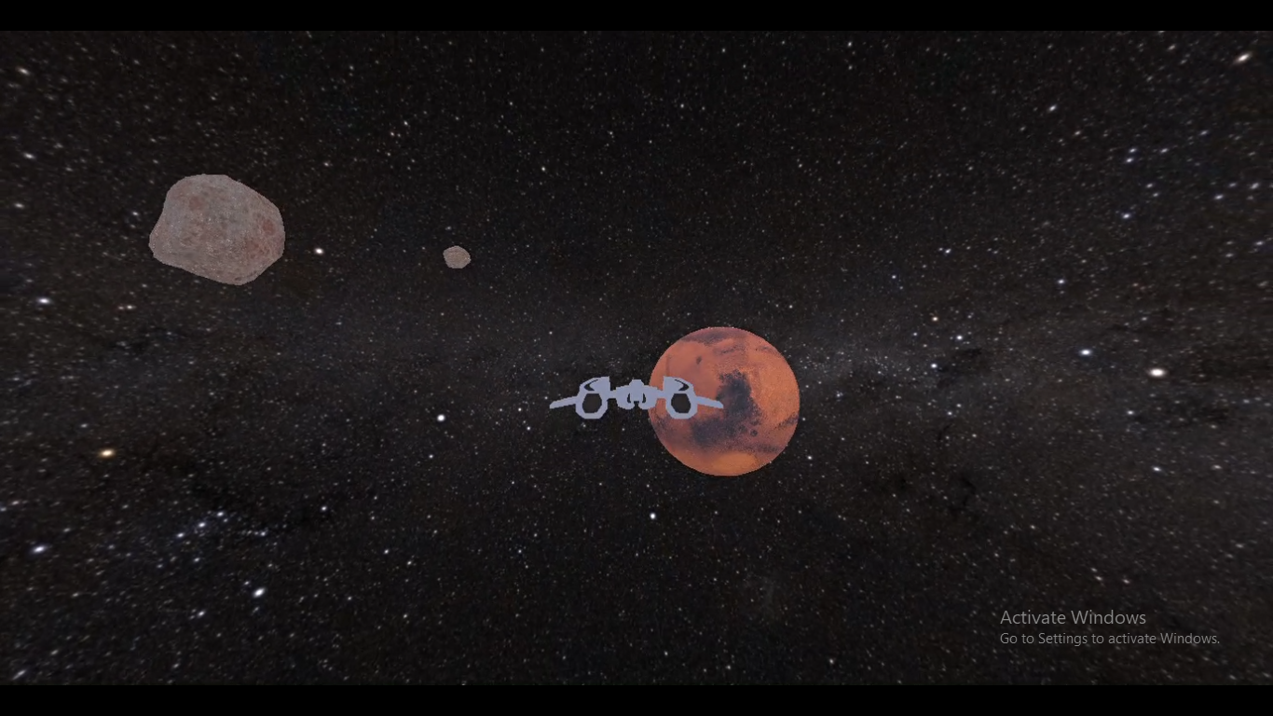
Input System
InputListener and Input System are the classes to handle the input via keyboard and mouse. Moreover, this class is, like a graphics engine, a sub system of a game engine and it handles input devices like keyboard and mouse using OS APIs having functions like ::GetCursorPos() and ::GetKeyboardState() etc and input listener are derived to override pure virtual functions.
Physics
Gravity class is used to determine the gravitational field Intensity of the planets and collision is detected by calculating force between Spaceship and that heavenly object.

Slide 10
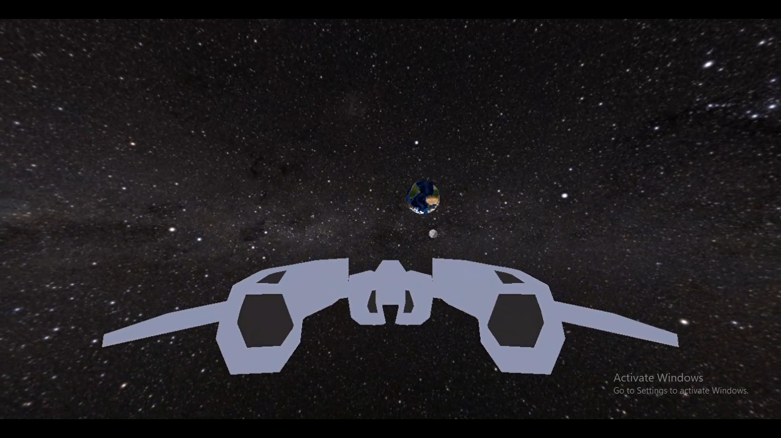
Following virtual functions are overridden from polymorphic base classes Window and InputListener in the SpaceRiderGame Class.
// Inherited via Window
virtual void onCreate();
virtual void onUpdate();
virtual void onDestroy();
virtual void onFocus();
virtual void onKillFocus();
virtual void onSize();
// Inherited via InputListener
virtual void onKeyDown(int key);
virtual void onKeyUp(int key);
virtual void onMouseMove(const Point&);
virtual void onLeftMouseDown(const Point&);
virtual void onLeftMouseUp(const Point&);
virtual void onRightMouseDown(const Point&);
virtual void onRightMouseUp(const Point&);

Slide 11
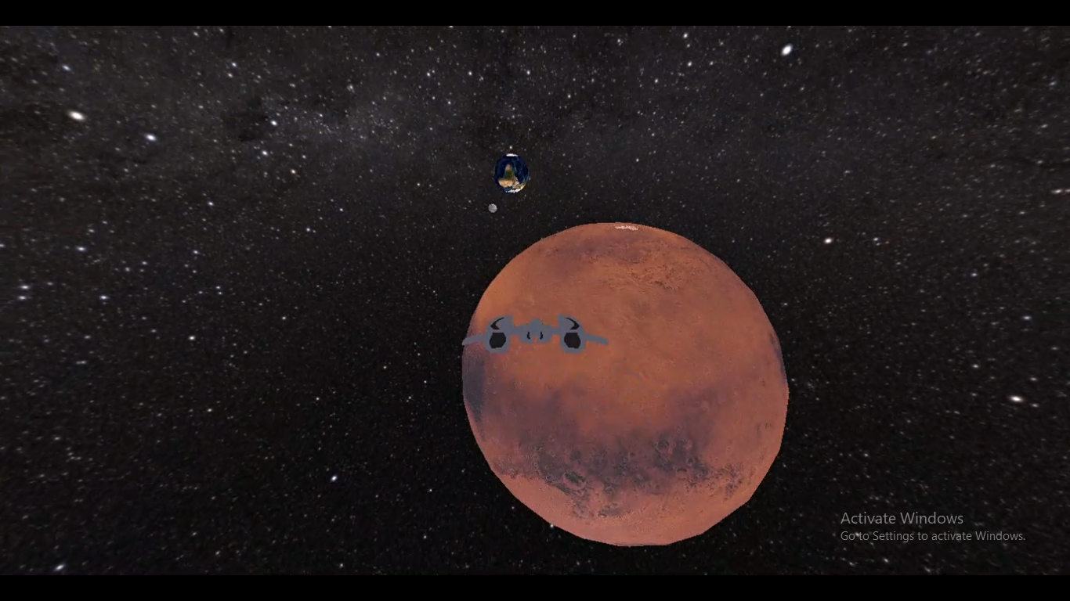
Above virtual functions from polymorphic base classes Window and InputListener are overridden in the SpaceRiderGame Class for spaceship movement, turbo speed, full screen, rotating camera and so on as per the requirements.

Slide 12
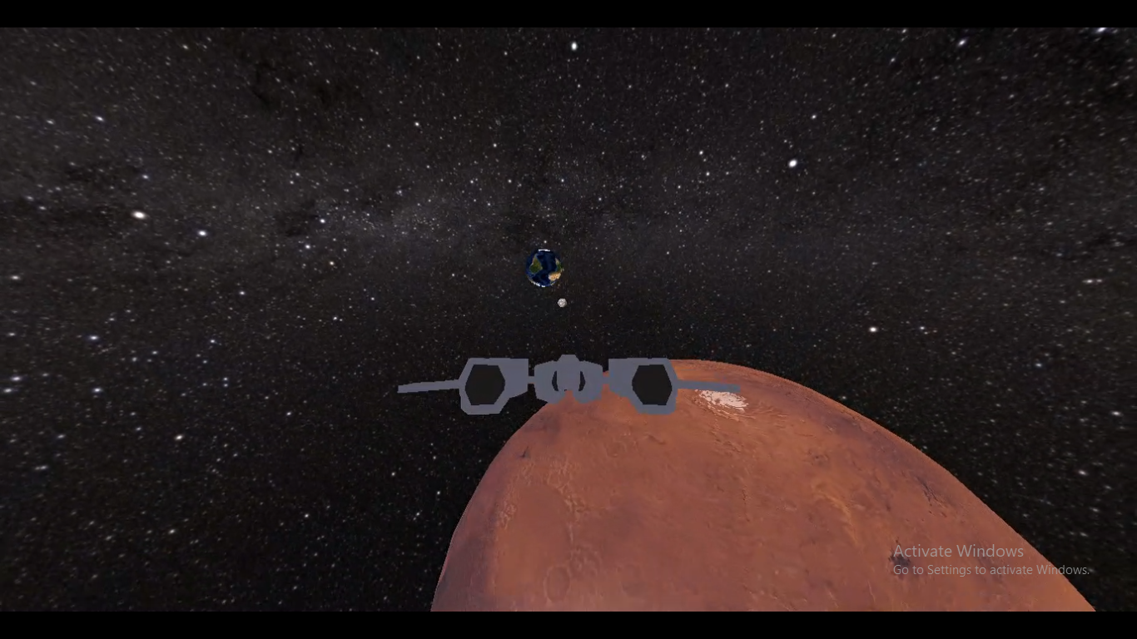
In math filter we have classes for vectors and matrices which best implements the operator overloading concepts by overloading all mathematical operators.

Slide 13
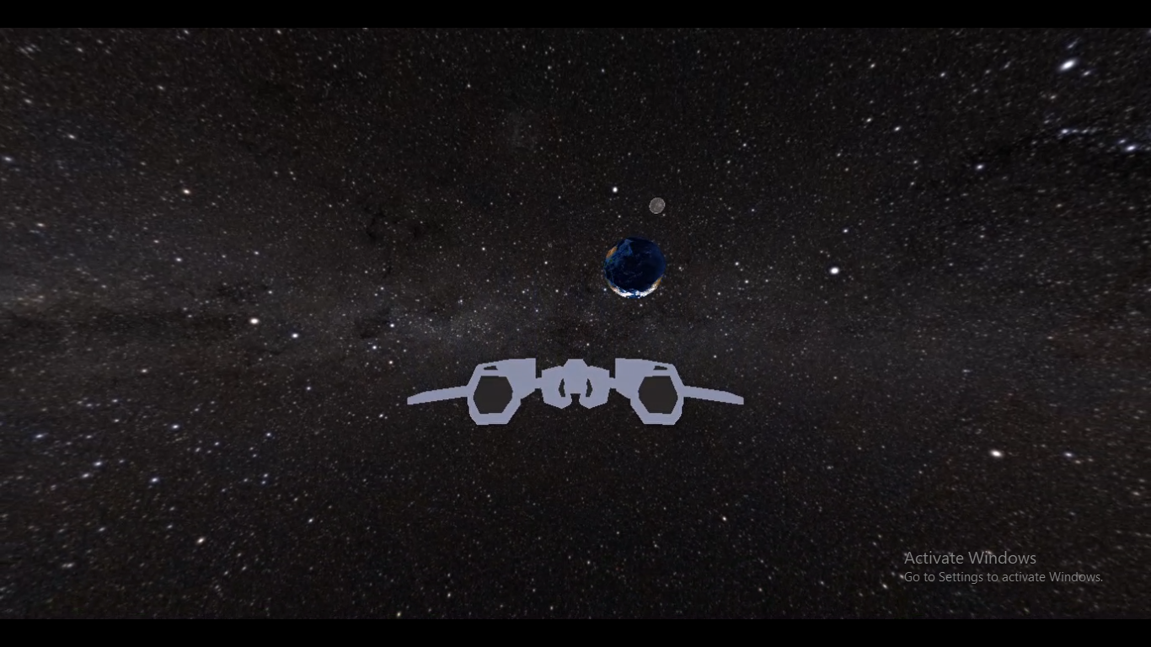
Abstract classes :
InputListener

Slide 15
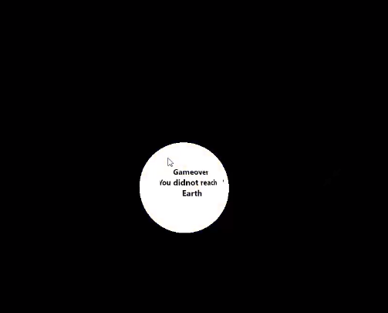

When collision occurs
it shows
When player wins

Slide 16
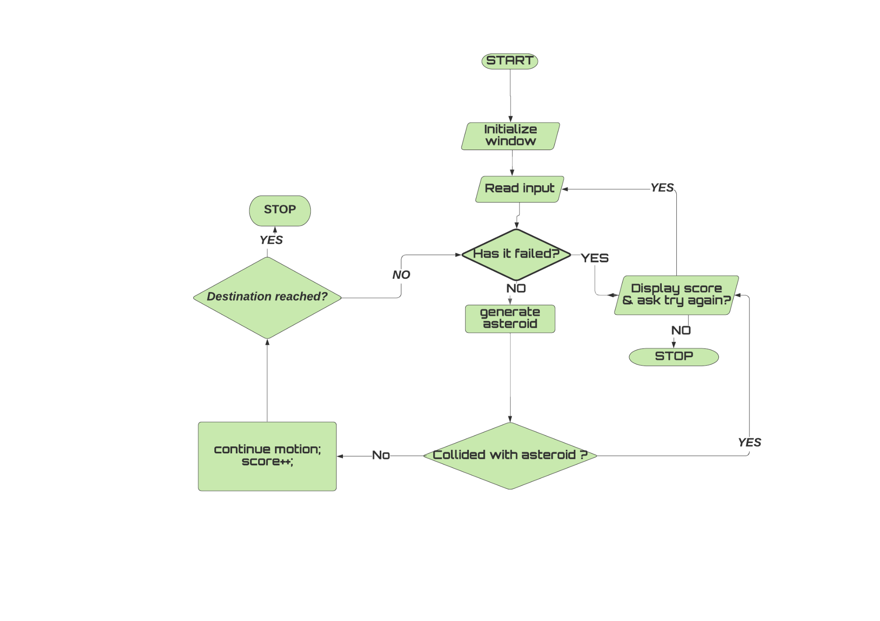
Block Diagram

Slide 17
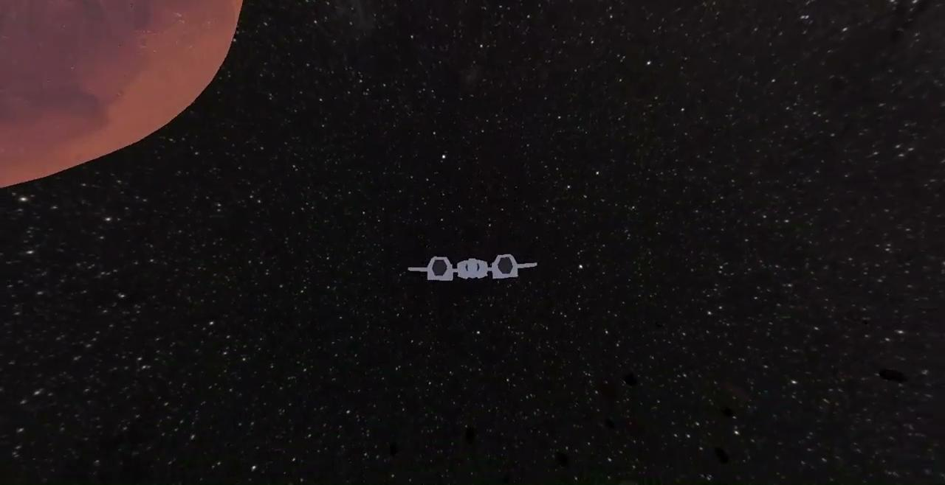
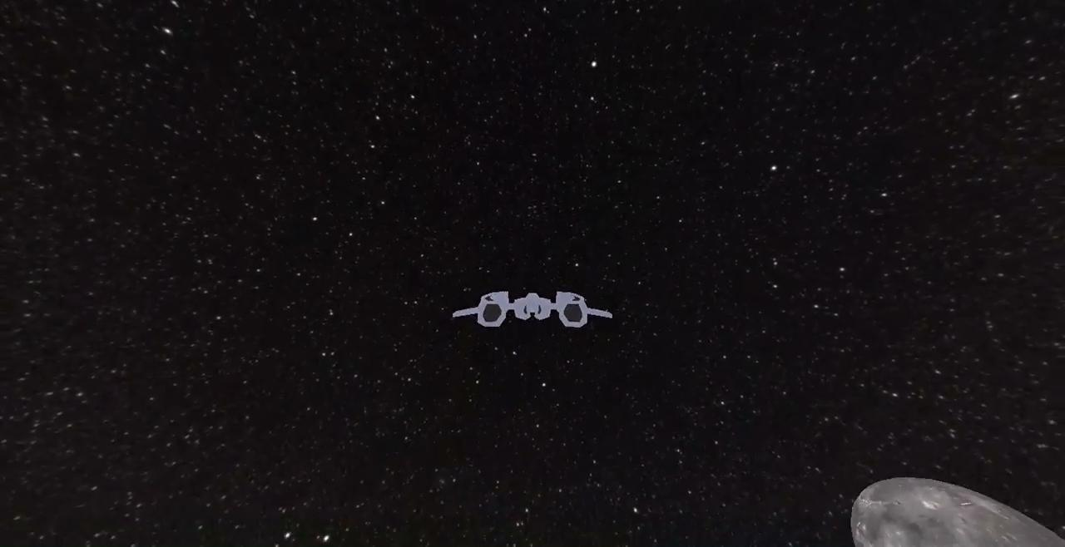
Results

Slide 18
References
Daya Sagar Baral and Diwakar Baral, “The Secrets of Object-oriented Programming”, Bhundipuran Prakasan
https://docs.microsoft.com/en-us/windows/win32/direct3d11/dx-graphics-overviews
https://github.com/microsoft/DirectXTK/wiki
Frank D. Luna “Introduction to 3D Game Programming with DirectX 11”

